Slide 1


Join the design team!
Jan-Christoph Borchardt @jancborchardt

Slide 2
Keep it simple

Slide 3
design
papercut
starter issue

Slide 4
Our great design community

Slide 5
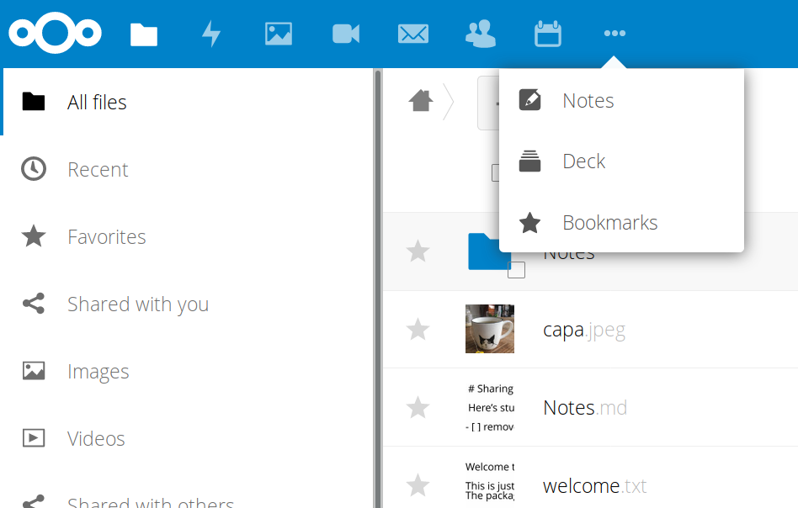
Responsive app menu
#4439 @juliushaertl

Slide 6
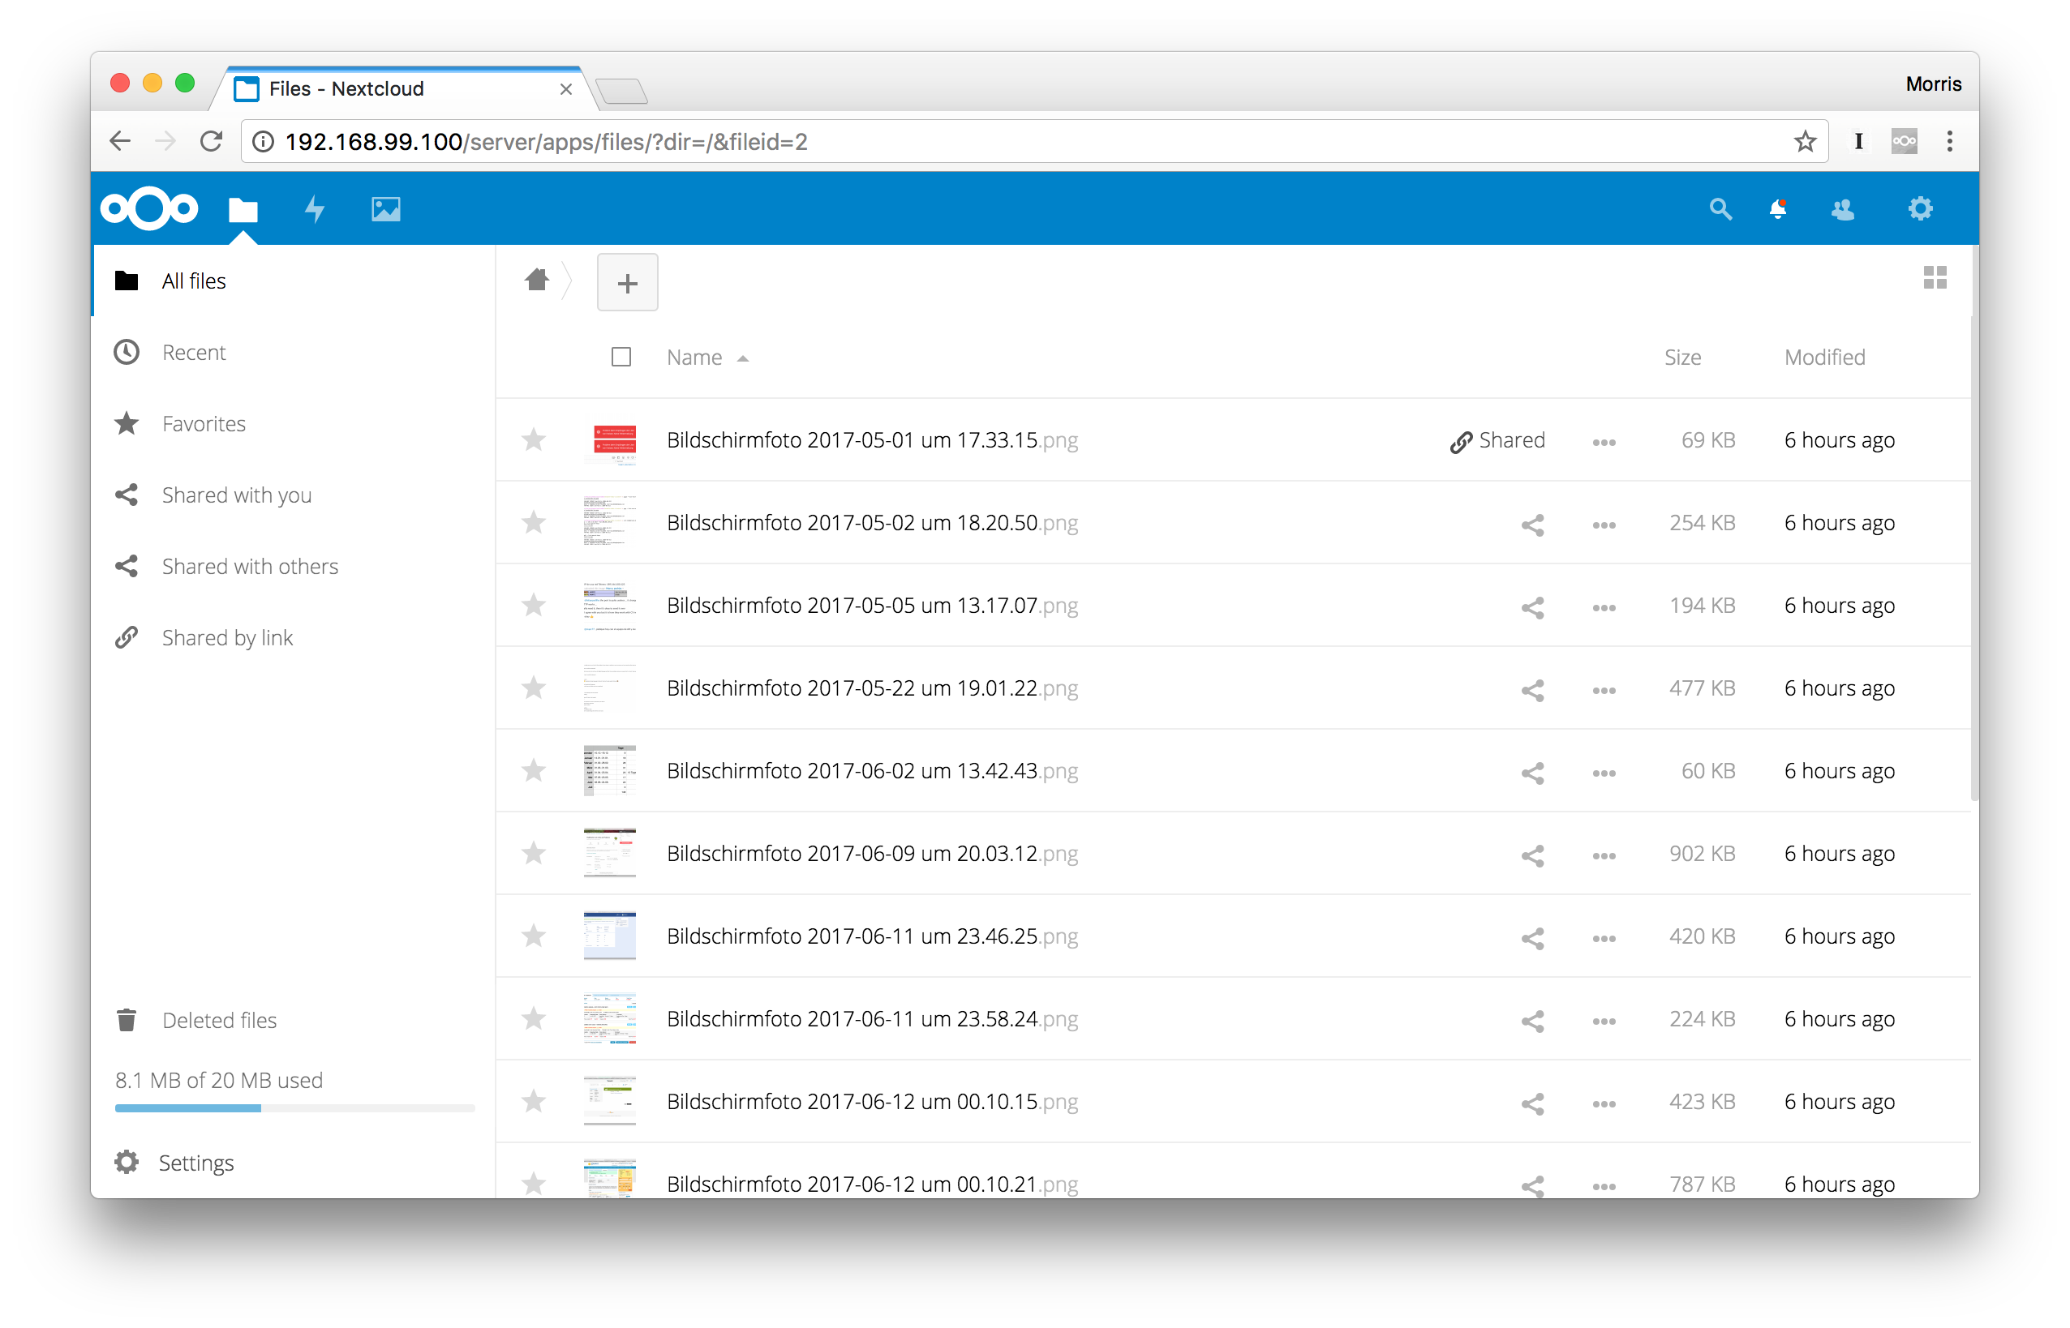
Add quota to the files view
#5305 @nickvergessen @MorrisJobke

Slide 7
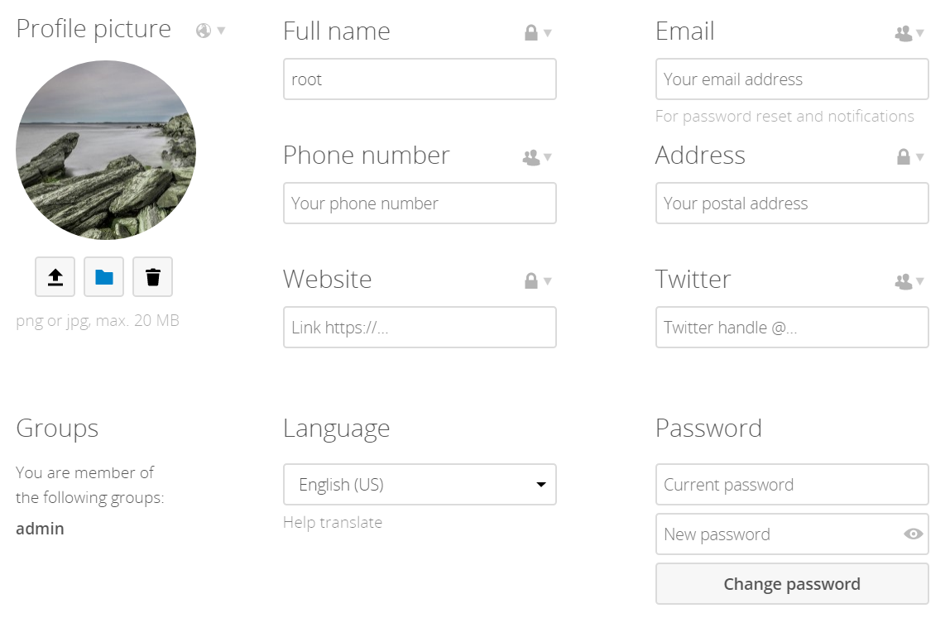
Cleaned up personal settings page
#5550 @andreasjacobsen93

Slide 8
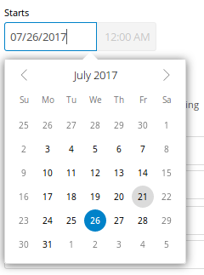
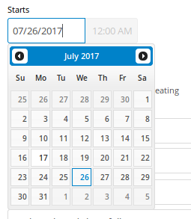
Redesign jQuery UI datepicker
#5713 @pixelipo

Slide 9
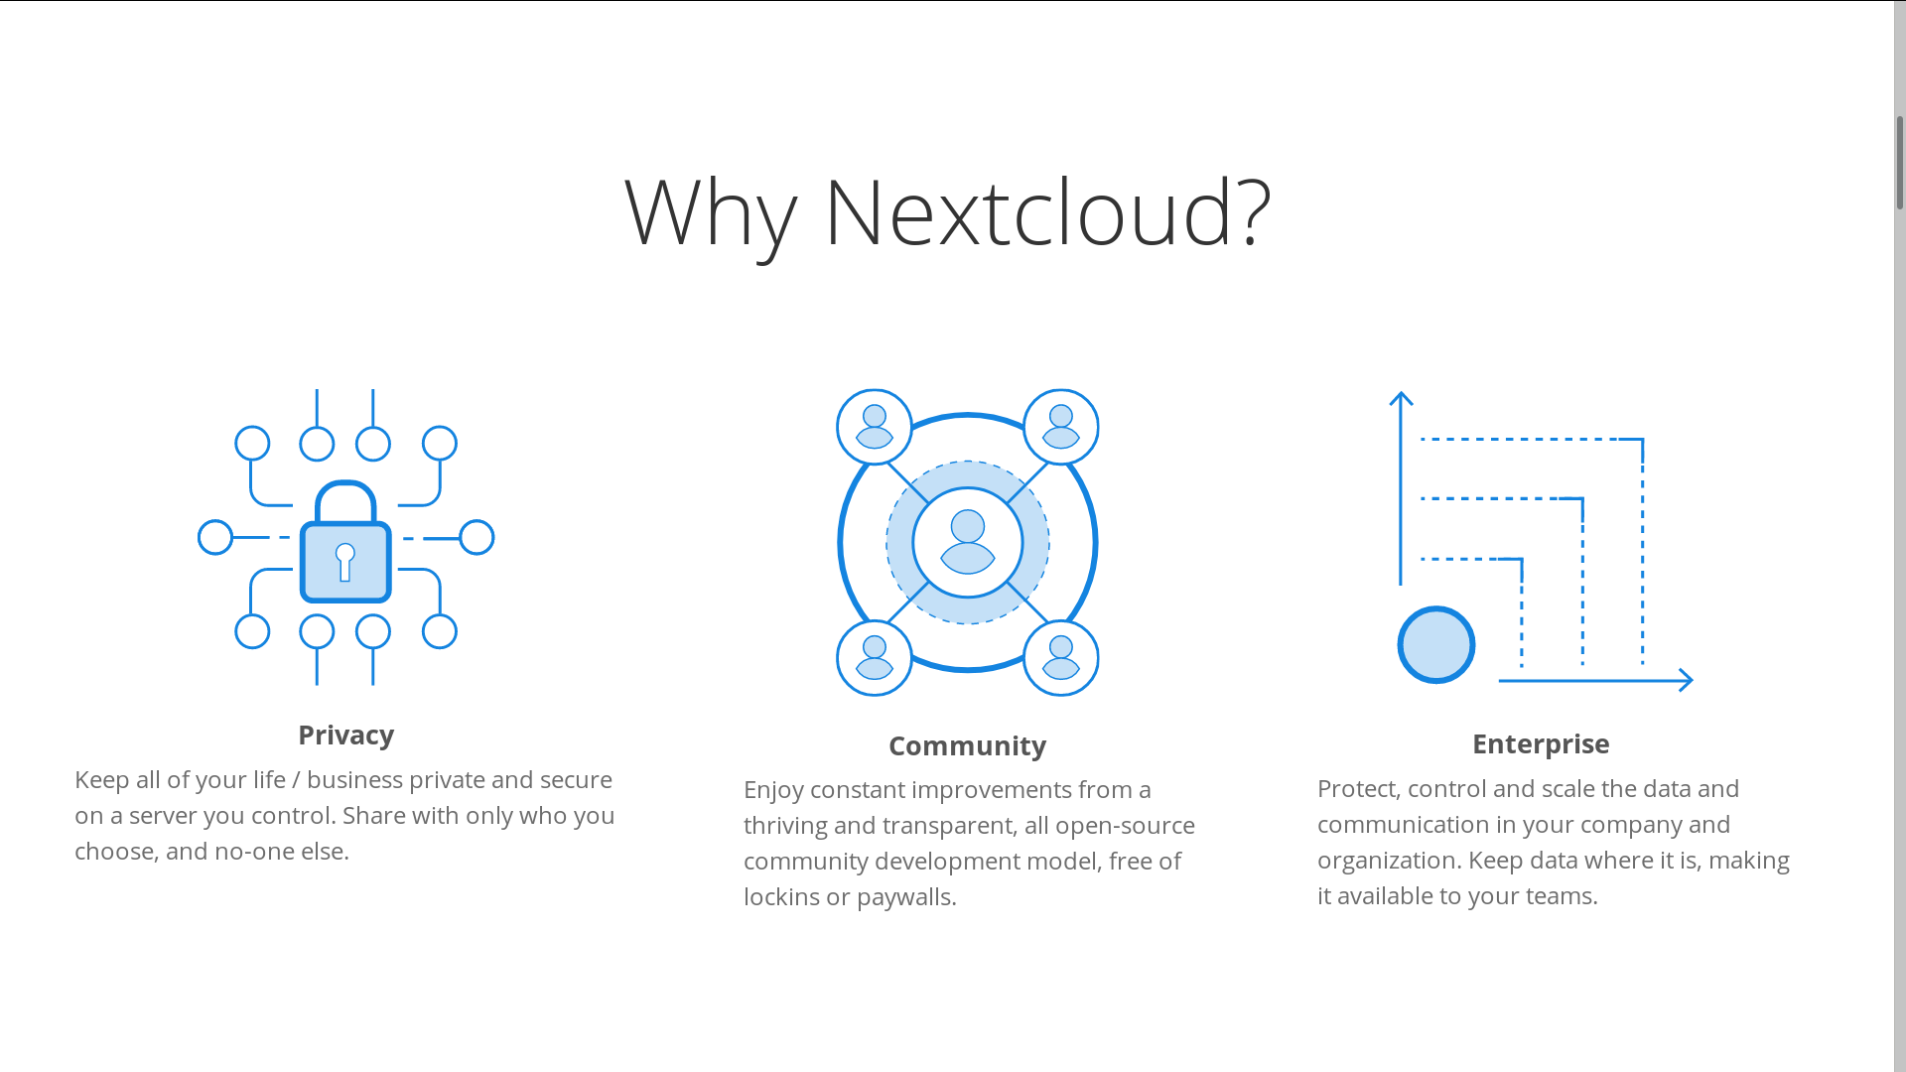
Website & illustrations
@Espina2

Slide 10
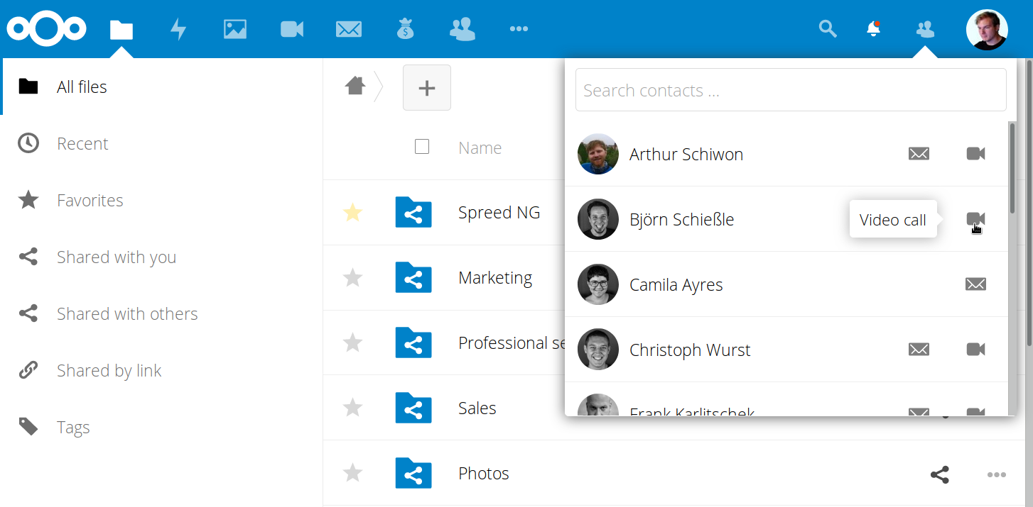
Contacts menu
#3233 @ChristophWurst

Slide 11
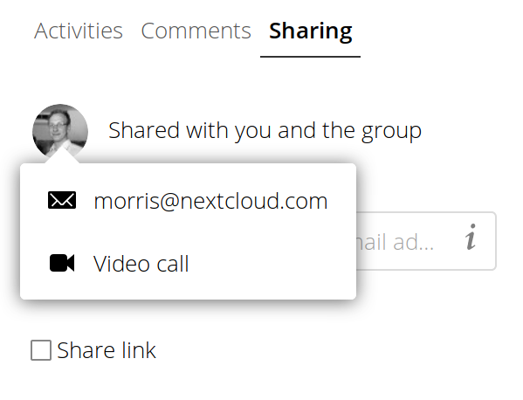
Add contacts popover
#4374 @georgehrke

Slide 12
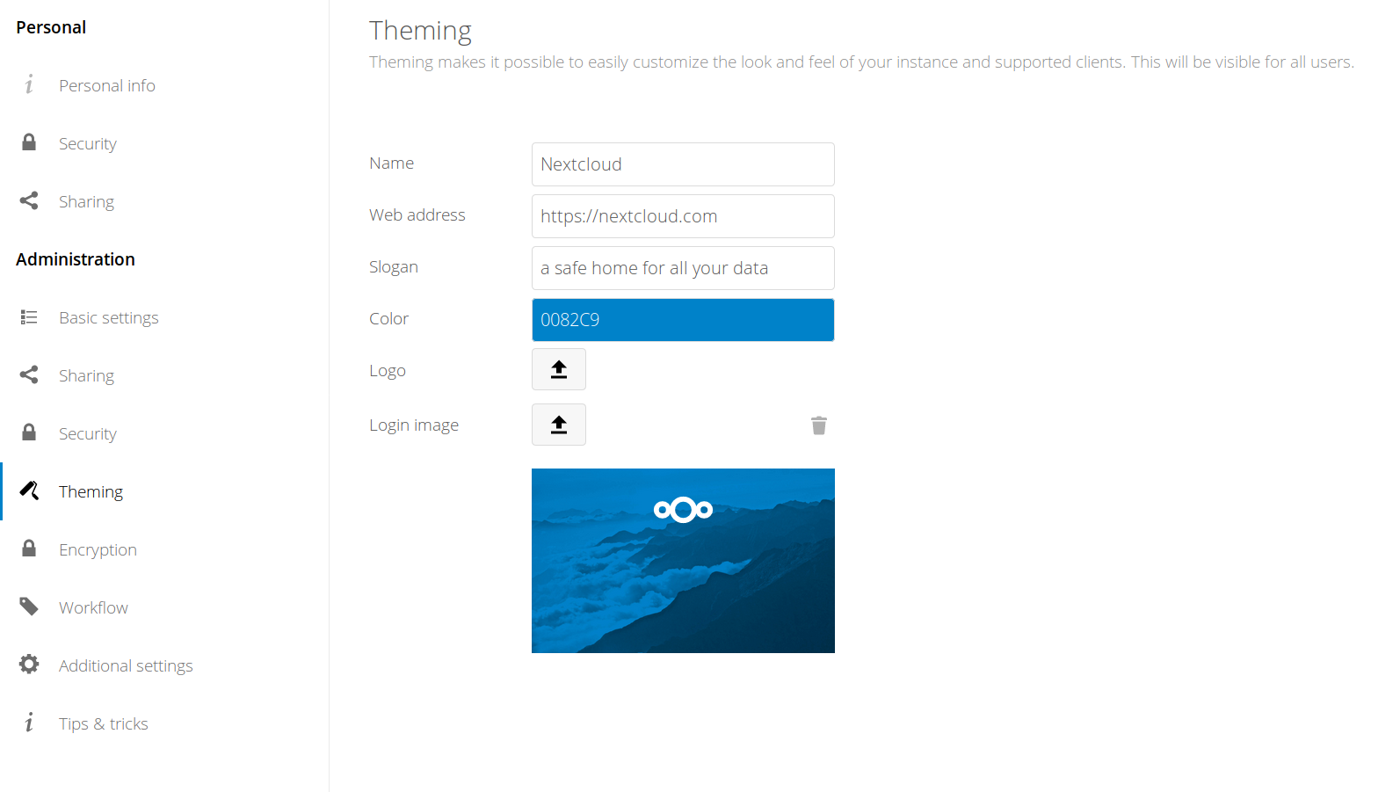
Unify settings
#4890 @blizzz

Slide 13
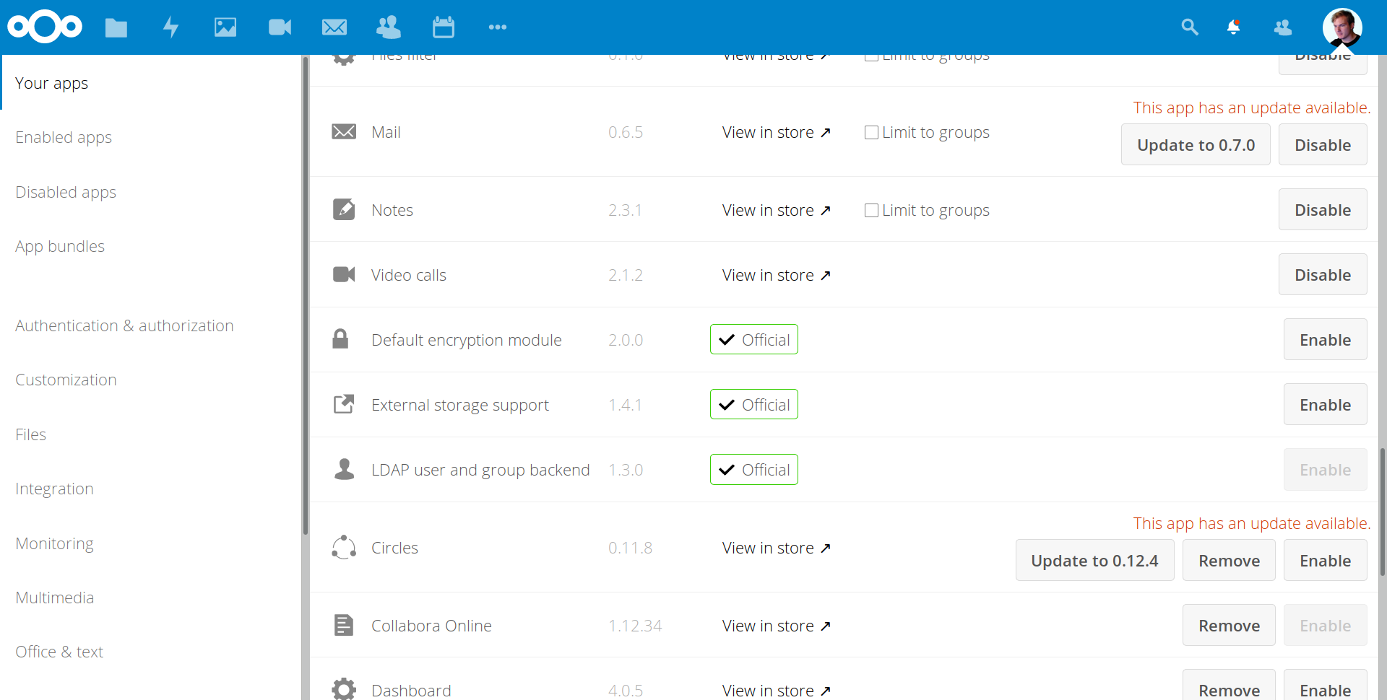
Make apps settings tabular
#3195 @eppfel

Slide 14
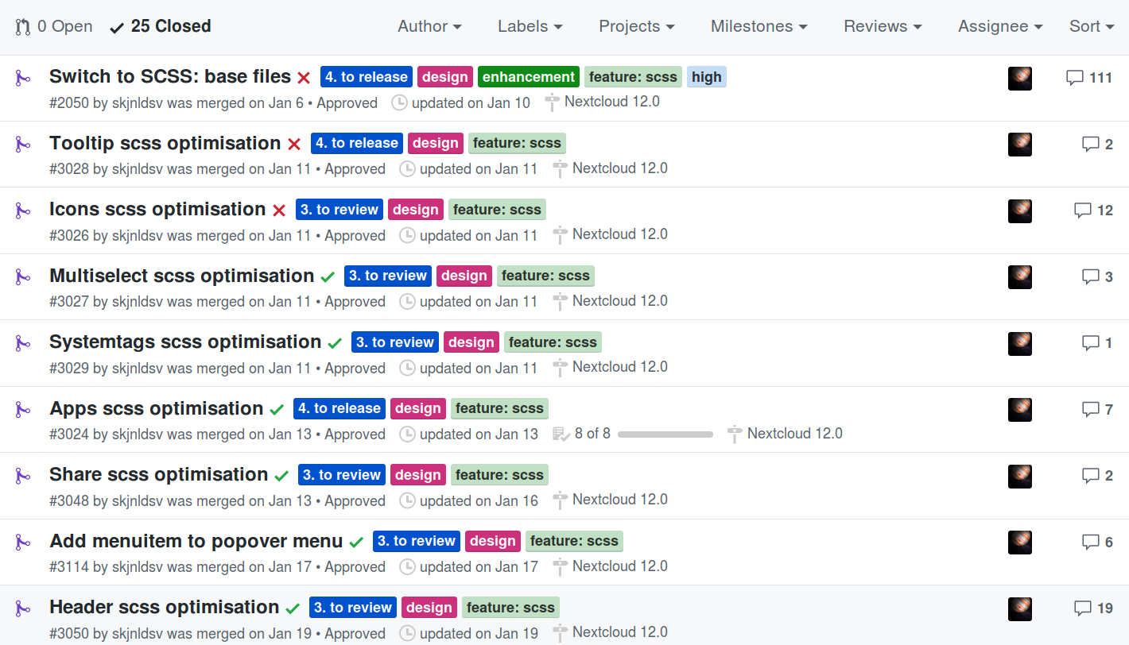
Switch to SCSS!
#2050 @skjnldsv

Slide 15


Replace loading icon GIF with pure CSS in login button #5972 @danxuliu

Slide 16
Work in progress to get involved

Slide 17
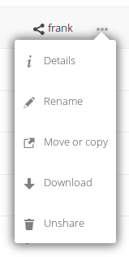
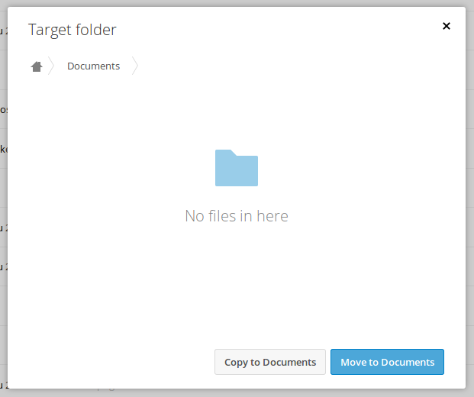
Add option to copy files
#3206

Slide 18
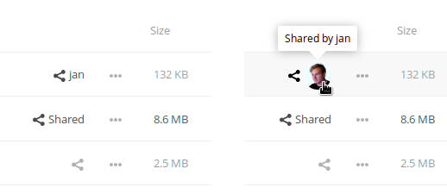
Show avatar instead of username for shared files #6094

Slide 19
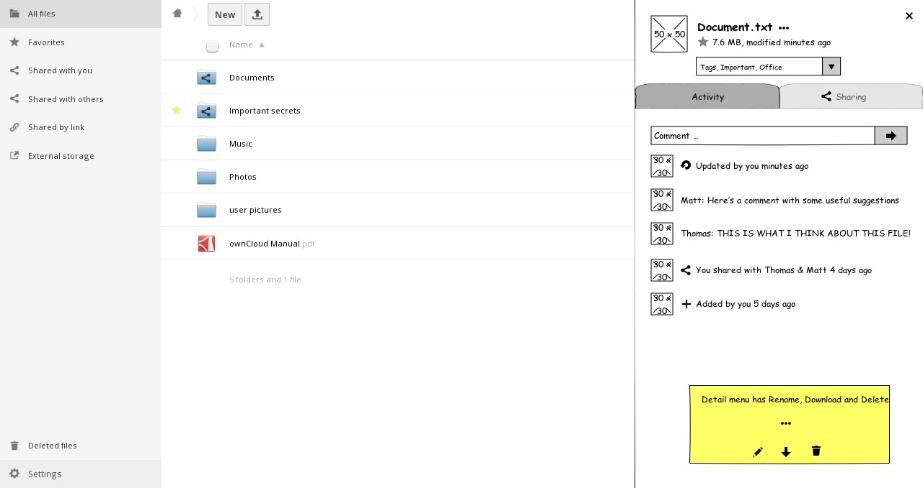
Combine Activity, Comments & Versions in »Activity« timeline #658

Slide 20
Help out apps
Contacts, Maps, Bookmarks, …

Slide 21
Design discussion this afternoon :)
Jan-Christoph Borchardt @jancborchardt

